Slide 1

Feetback Hardware
Tomi Lahdenperä, Juho Kantola, Tommi Ovaskainen
TVT18SPL

Slide 2

Ideas in the beginning
Three goals:
Measures time in the air
Calculates users jump height
Measures each leg jumping force

Slide 3

Meeting with Polar Electro
We listened to their requirements to make the mat
Rollable
Durable as possible
Cheap as possible
Simple as possible

Slide 4
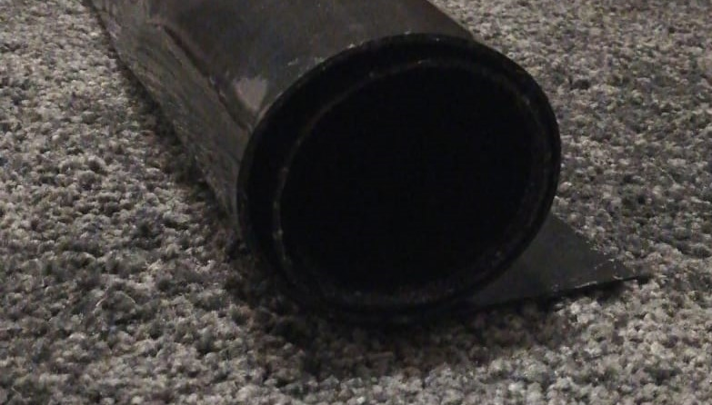
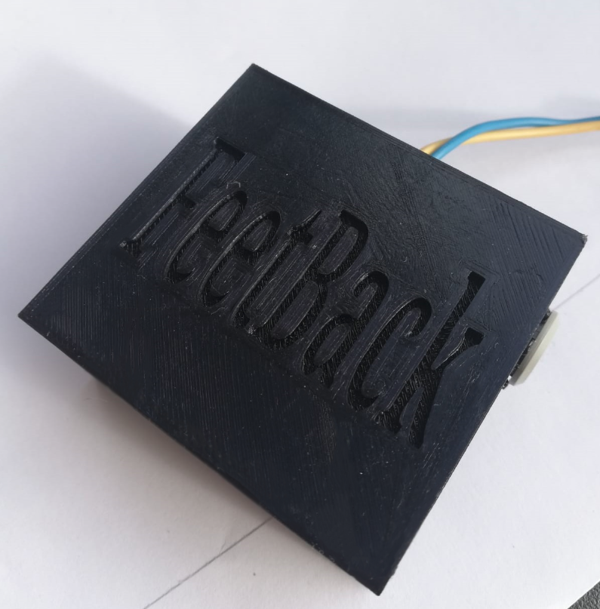
Choosing the right materials
Rubber sheet from hardware store
Designed and printed our case for the components with PLA

Slide 5
Choosing the right components
Arduino nano
HC-05 Bluetooth module
Velostat

Slide 6

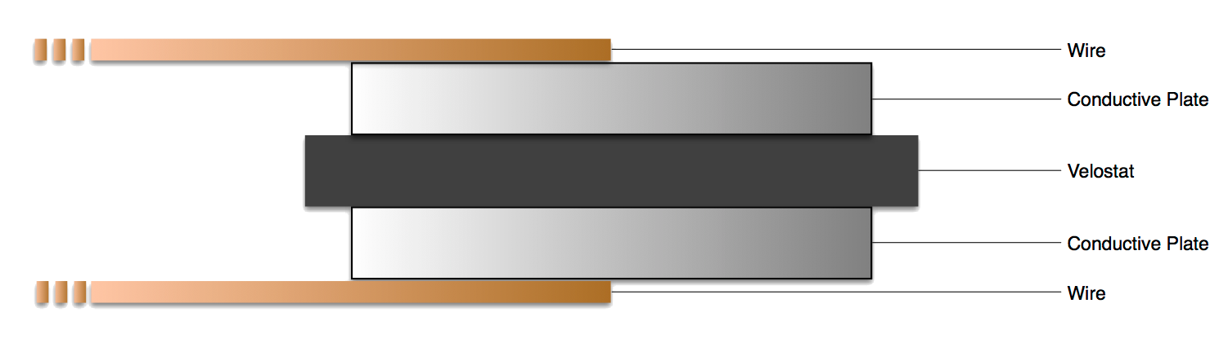
Velostat

Slide 7
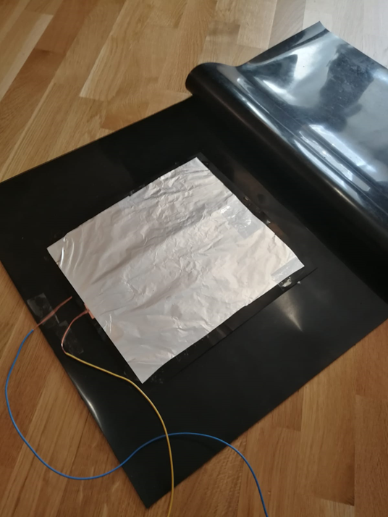
Mat assembly
Two pieces of rubber sheets 50cm x 50cm
Velostat film, tinfoil both sides acting as a conductive material and contact paper holding everything in place
Rubbersheets glued together

Slide 8
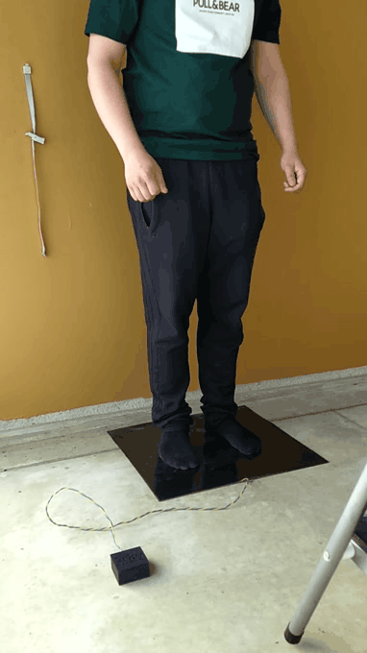
Mat testing
Durability -> 300-400 jumps done
Accuracy -> about 100 measured jumps
The limit values changed too much as testing progressed
The pull-up resistor replaced with a pull-down
-> The height of the jump was again accurately measured

Slide 9

Combining the mat and application
Application and hardware work almost perfectly in the beginning
Time was wasted looking for a problem because the Velostat film had broken inside the mat

Slide 10
Final thoughts
What went well
We chose good materials right in the beginning
Communication
Staying on schedule
What went not so well
Lack of testing
Forgot to update Jira
Wrong kind of resistor in the beginning

Slide 11
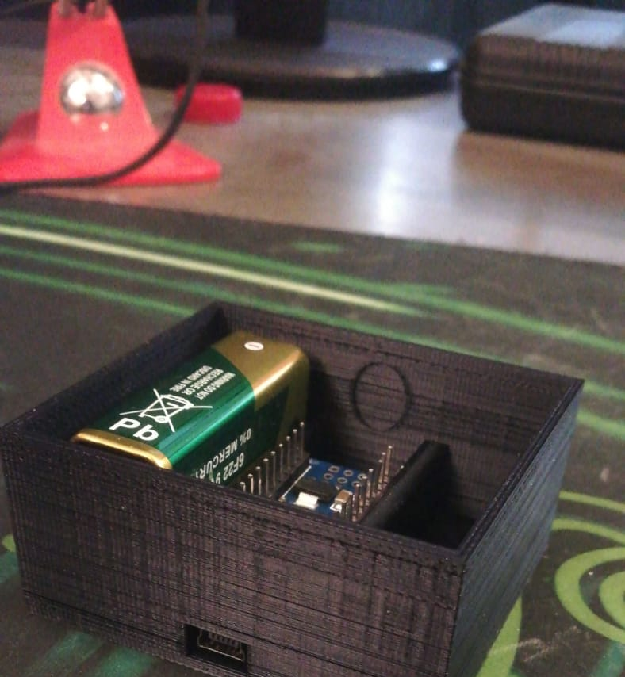
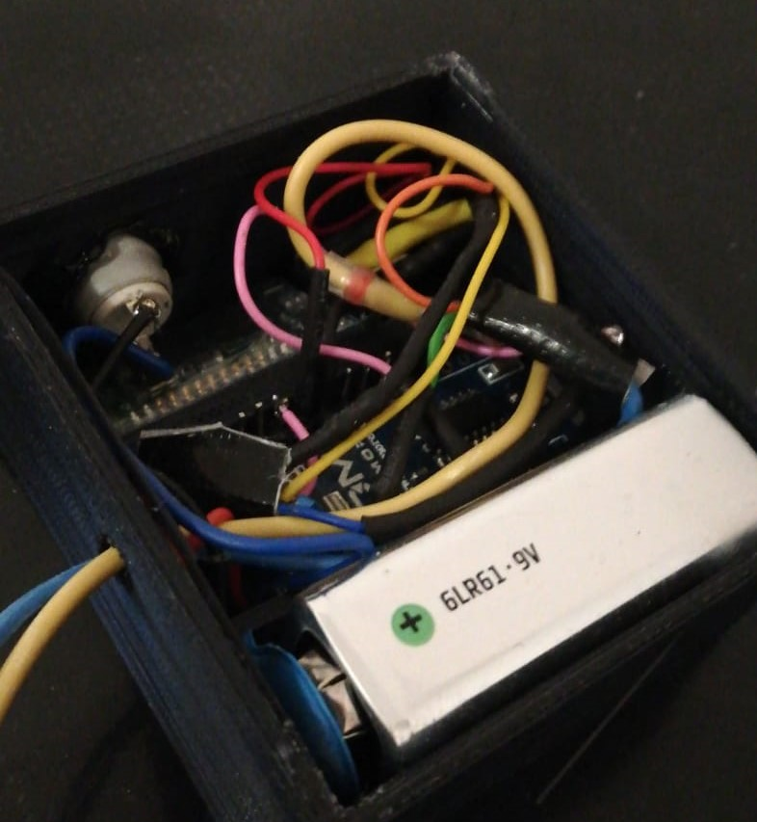

Slide 12
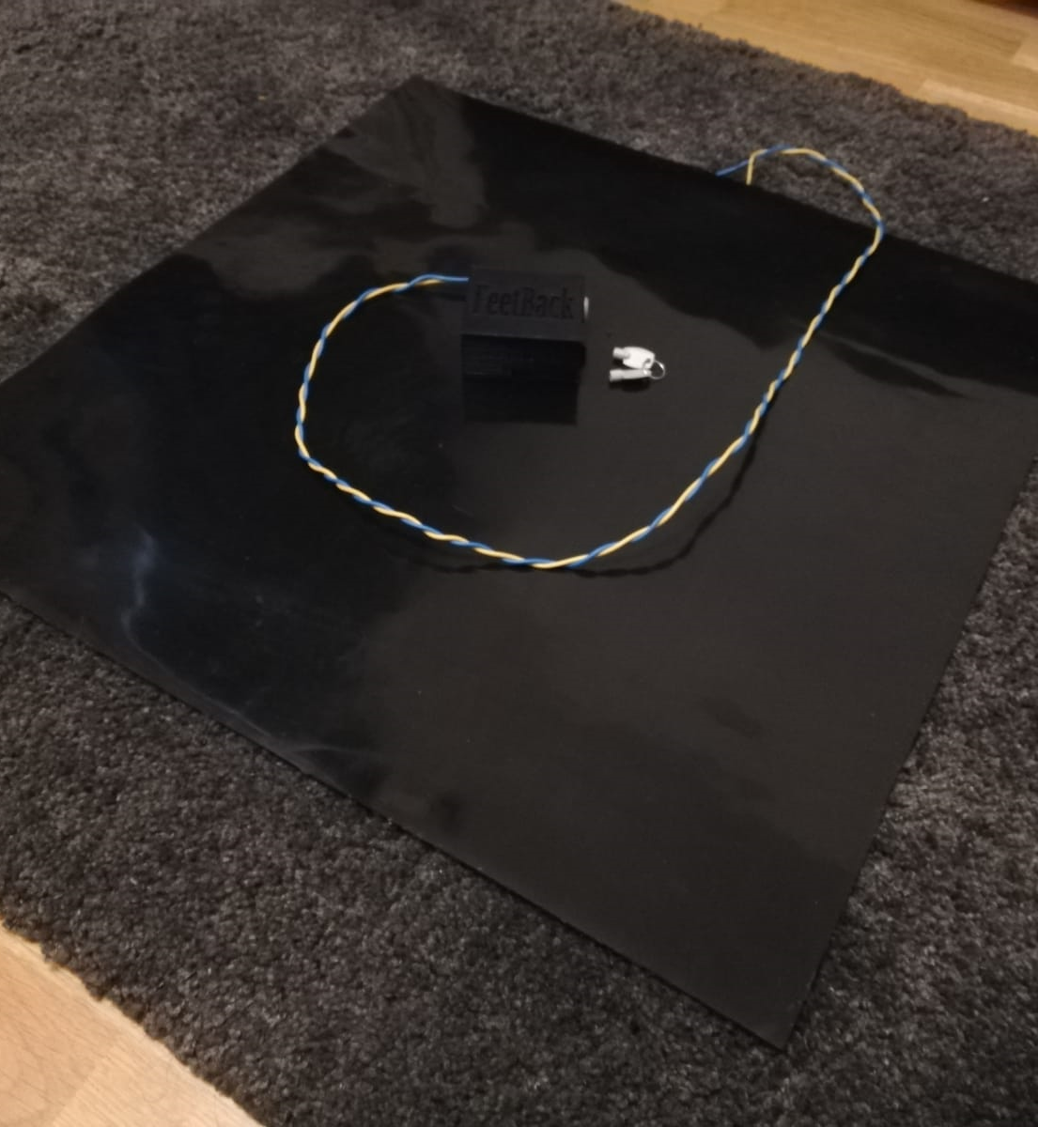
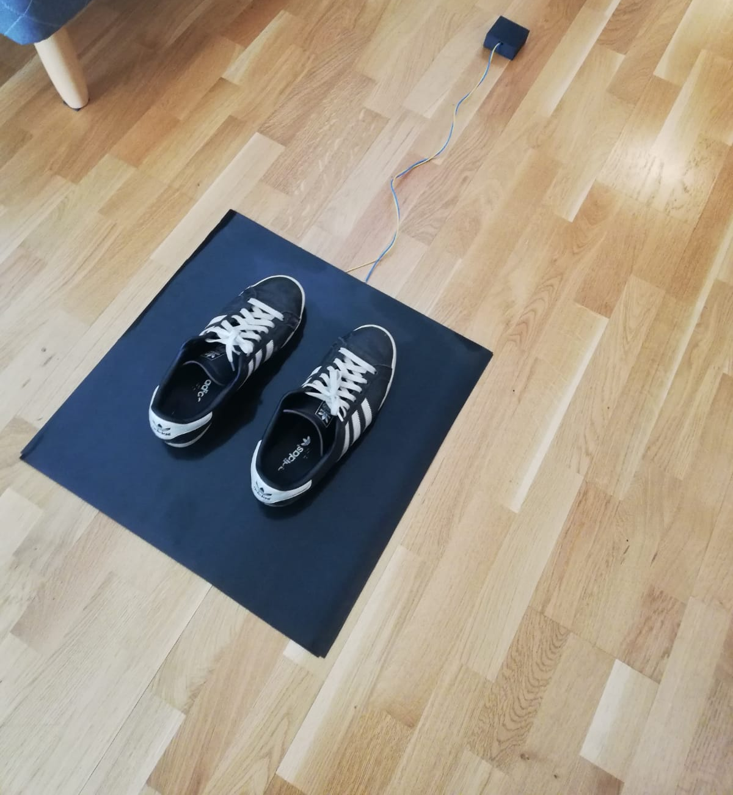

Slide 13
Feetback Software

Slide 14

Choosing the tools
Requirements:
Fast prototyping
Easy UI design
Versatile component library
Good documentation
Cross-platform possibilities

Slide 15



Our choice

Slide 16



WHY?

Slide 17

Used by big players

Slide 18


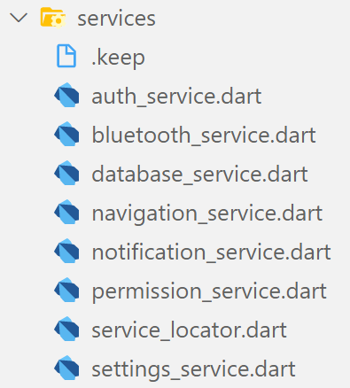
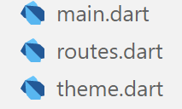
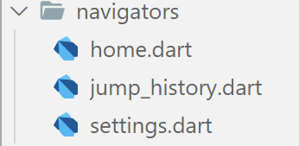


Architecture

Slide 19

Reflection
New programming language
New way of working
A fast learning team
Complex navigation
Young framework

